Slide 1
Predicting Student Success of Finishing their Major
Client: Dr. Nancy Floyd, Institutional Analytics
Statistics Consultants: Katherine Allen, Andrew Giffin, and Robert Pehlman
Adviser: Dr. Consuelo Arellano

Slide 2
Project description
The Office of Institutional Analytics is interested in identifying “pressure points” in academic major programs – courses or course combinations that have a gatekeeper effect in determining whether a student would be able to finish their major.

Slide 3
Project description
Goal: the ability to advise students mid-college on the likely success of their chosen majors; recommend interventions when necessary.

Slide 4
data
All undergraduate student course enrollments, with grades, majors and major changes, and degree awarded for all students at NCSU from 2001 to 2013.
Sorted into 19 files: 3 main files of student information by term, (700k rows of student info) course level student information, (3.7 million rows of student info) information on graduation details, (50k rows of student info) and 16 lookup dictionaries.

Slide 5
Data
Examining student GPA, course level, year, and major on both the term level and throughout a student’s entire career at NCSU

Slide 6
METHODS
Possible strategies:
LASSO logistic regression, for each major
(regular) logistic regression (increased predictive ability; decreased interpretability)
Instead of SUCCESS/FAILURE prediction, attempting to predict numeric final grade

Slide 7
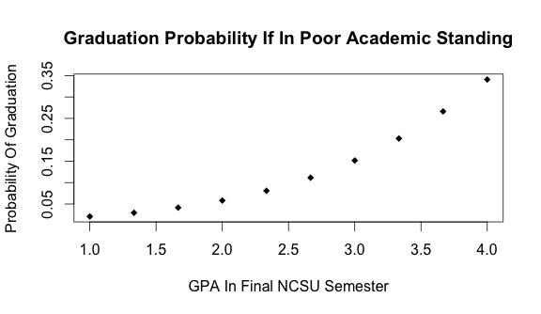
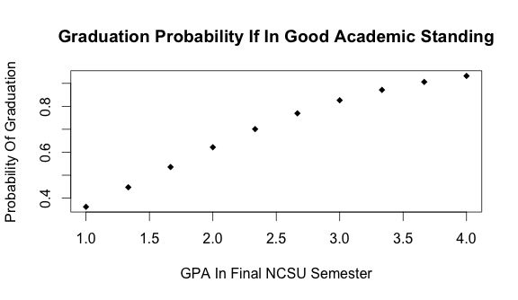
Initial Analysis

Slide 8
Considerations
Data size (800MB of data)
Non-identifiable data
Confounders: individual professors; curriculum changes

Slide 9
Questions?

